Slide 1
Stroke Risk Factor Analysis
By Taija Grace & alex ruder

Slide 2
Abstract
Stroke is a major neurological emergency, the 2nd leading cause of death and top cause of long‑term disability. Globally, 15M cases occur yearly, with 6.2M deaths and 5M disabilities. In the U.S., a stroke happens every 40 seconds (795K/year, $34B cost). Ischemic strokes (87%) result from artery blockage; hemorrhagic strokes from vessel rupture. Up to 80% are preventable by managing hypertension, hyperglycemia, atrial fibrillation, smoking, and obesity.

Slide 3
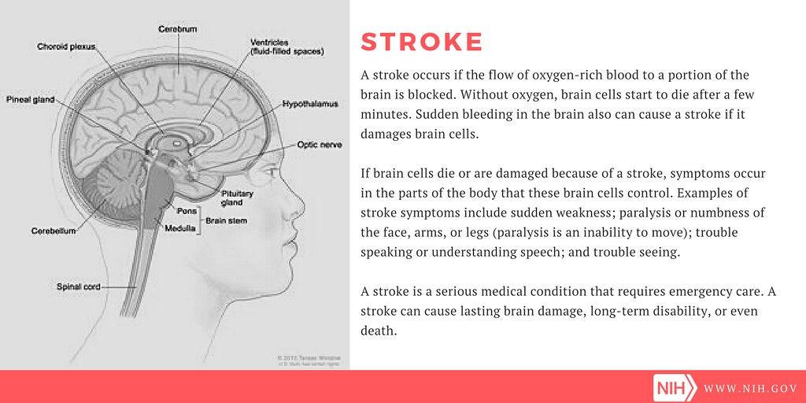

Slide 4
Problem
Routine primary care collects key clinical data—age, blood pressure, glucose, BMI, cardiovascular history, and lifestyle factors—but these are rarely turned into structured, evidence‑based risk assessments. Without converting raw data into actionable risk signals, many high‑risk patients go undetected. Current machine‑learning models are accurate but often opaque, complex, and hard for clinicians to interpret, limiting real‑world use.

Slide 5
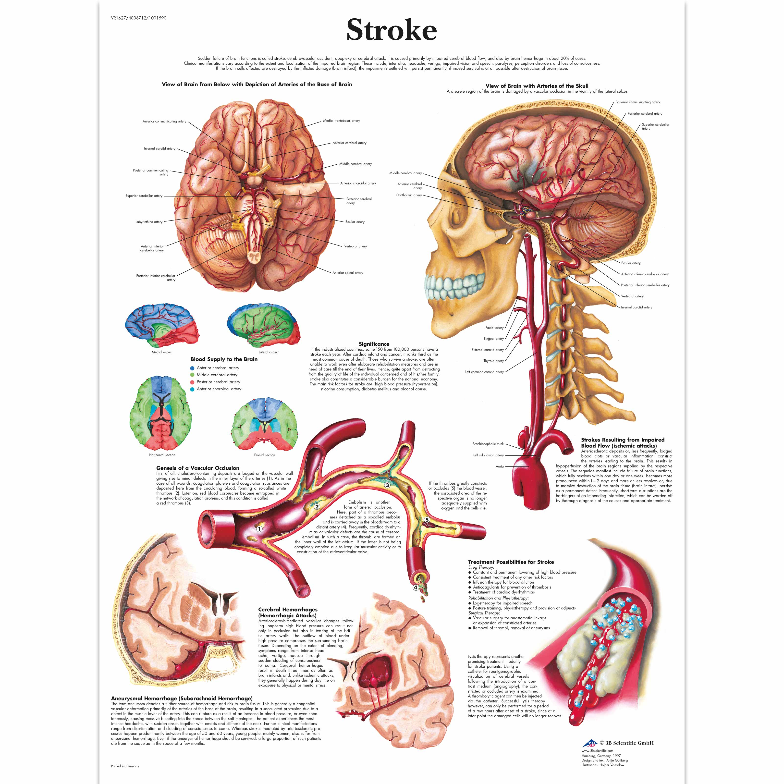

Slide 6
Approach
This study uses transparent, interpretable statistics on 5,110 patients to detect known stroke risk factors. We apply simple, clinician‑friendly methods—T‑Tests, Chi‑Square, ANOVA, Quartile Analysis, and Patient Segmentation—to reveal meaningful patterns and high‑risk subgroups. This shows how routine clinical data can be turned into clear, actionable early‑risk insights.

Slide 7
Dataset Description
Dataset Source — Kaggle (fedesoriano, 2021)
Sample Size — 5,110 patient records
Attributes — 12 total (demographic, medical, lifestyle, stroke label)
Demographics — id, gender, age, ever_married
Medical Factors — hypertension, heart_disease, avg_glucose_level, BMI
Lifestyle Factors — work_type, residence_type, smoking_status
Target Variable — stroke (binary: 0 = no stroke, 1 = stroke)
Class Imbalance — 4,861 non‑stroke (95.13%) vs. 249 stroke (4.87%)

Slide 8
Methodology
Database Design — Data normalized into 3NF SQLite with five tables (patient, health, work type, residence type, smoking) to reduce redundancy and support efficient queries.
Data Cleaning — Missing BMI stored as NULL; smoking “Unknown” kept; high glucose (>200) and BMI (>60) validated and retained.
Descriptive Statistics — Computed mean, median, mode, SD, variance, quartiles; tabulated categorical frequencies.
Hypothesis Testing — Ten questions tested using T‑Tests, ANOVA, Chi‑Square, and Quartile Analysis at α = 0.05.
Patient Segmentation — Built a 5‑factor risk score (0–5) using hypertension, heart disease, glucose >140, age >60, and smoking; segmented patients by score and age group.

Slide 9
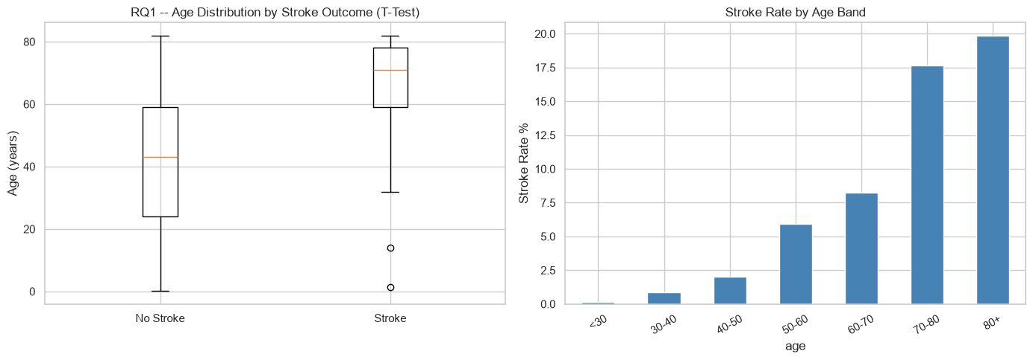
Age and Stroke Rate
Stroke patients had a mean age of 67.7 years vs 41.9 years for non-stroke patients. The independent T-Test yielded T = 22.94, p < 0.0001 highly significant. Senior patients (>60) had a 13.57% stroke rate vs 0.13% for patients under 30.

Slide 10
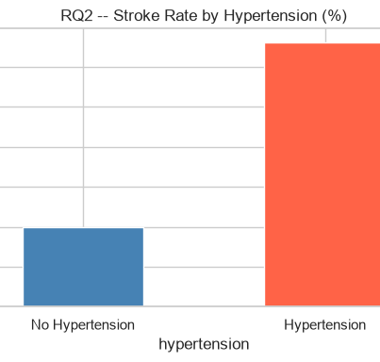
Hypertension and Stroke Rate
Chi-Square analysis: Chi2 = 81.61, p = 1.66e-19. Patients with hypertension had a stroke rate of 13.25% vs 3.97% without a 3.3x increase.

Slide 11
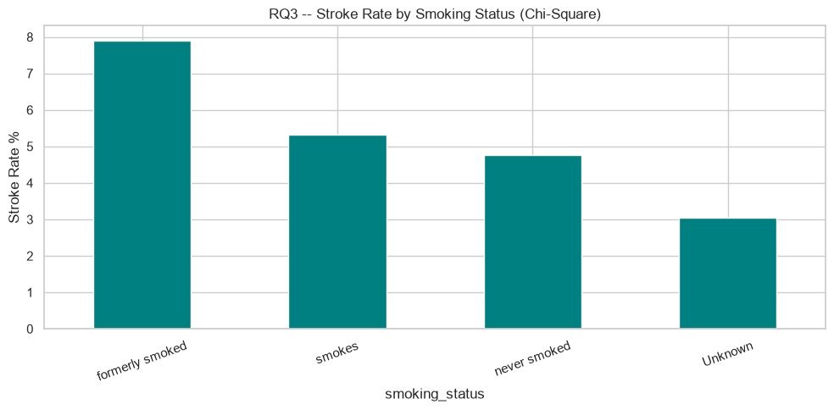
Lifestyle Factors
Work type showed significant ANOVA results (F = 12.40, p = 4.90e-10). Self-employed patients had the highest stroke rate (7.94%). Smoking status showed borderline significance (p = 0.079), likely attenuated by 30% missing values.

Slide 12
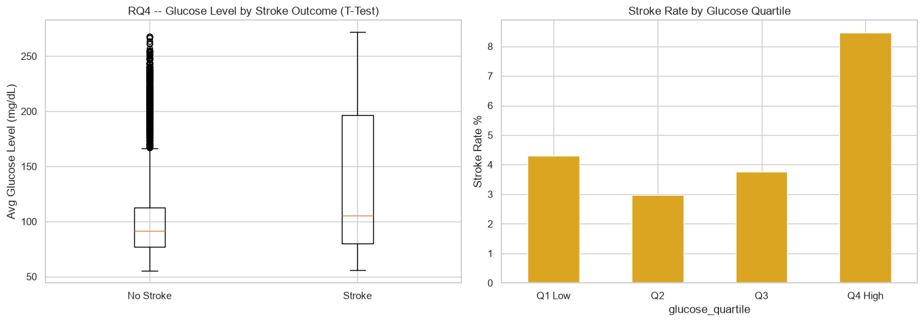
Glucose Level and Stroke Rate
T-Test: T = 9.51, p = 2.77e-21. Stroke group mean glucose was 132.5 vs 104.8 mg/dL. Quartile analysis confirmed a monotonic increase in stroke rate from Q1 (1.9%) to Q4 (10.9%).

Slide 13
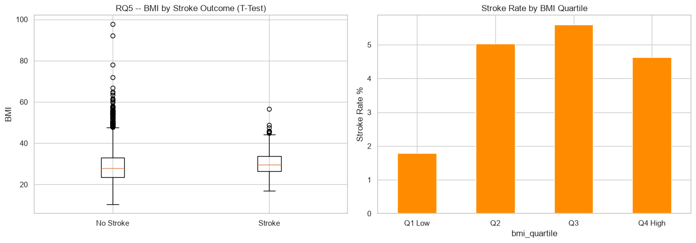
BMI and Stroke Rate
T-Test: T = 3.21, p = 0.0014. Stroke group mean BMI was 30.47 vs 28.82. BMI quartile analysis showed a non-linear pattern Q3 had the highest stroke rate (5.59%), not Q4.

Slide 14
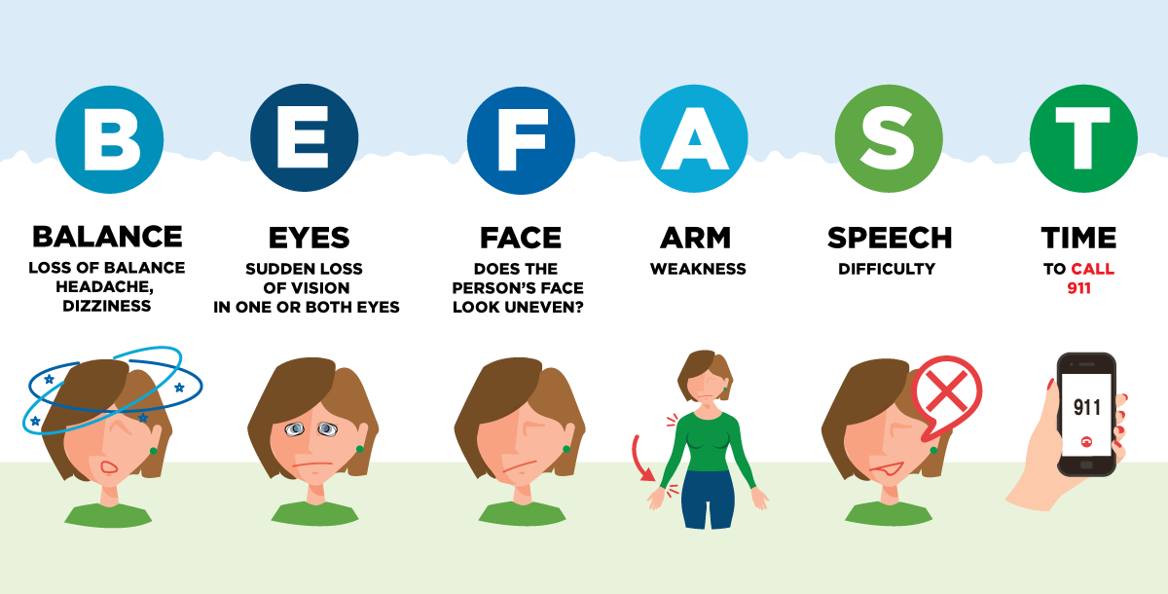

Slide 15
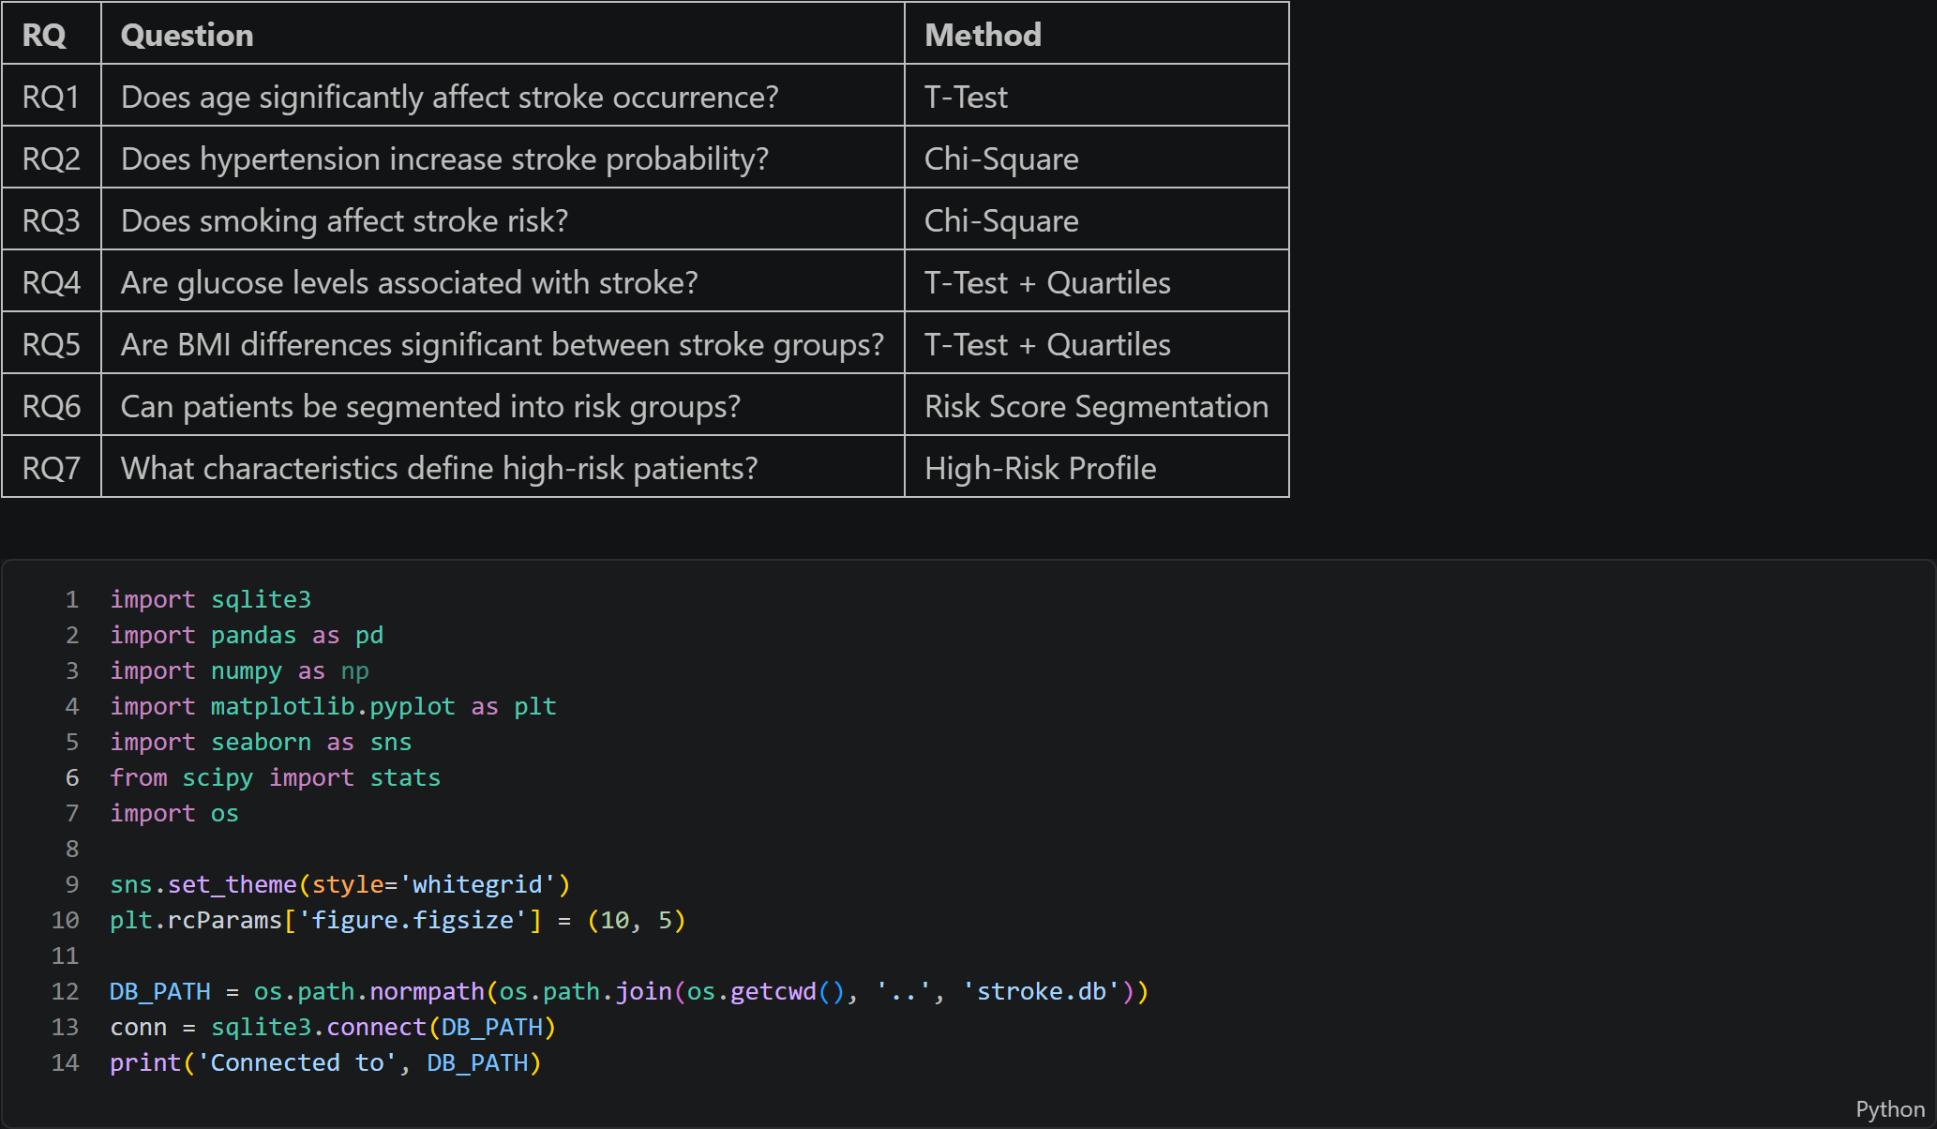
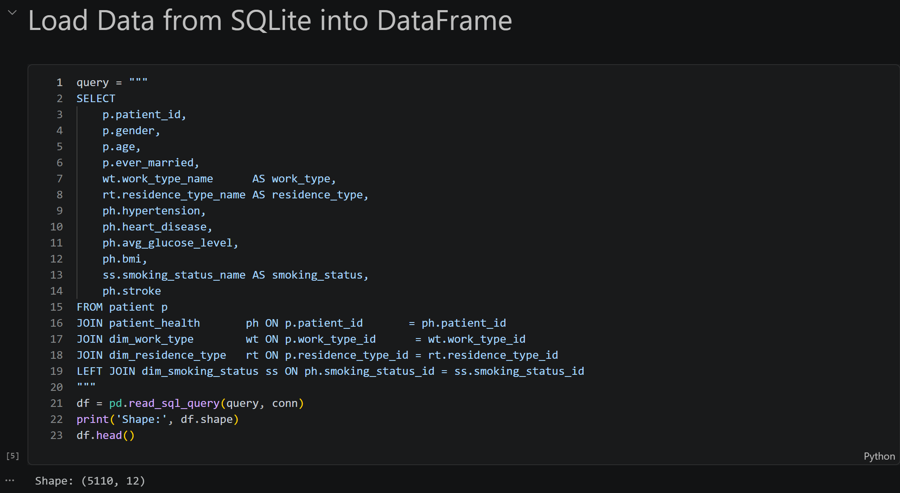
Data Output

Slide 16
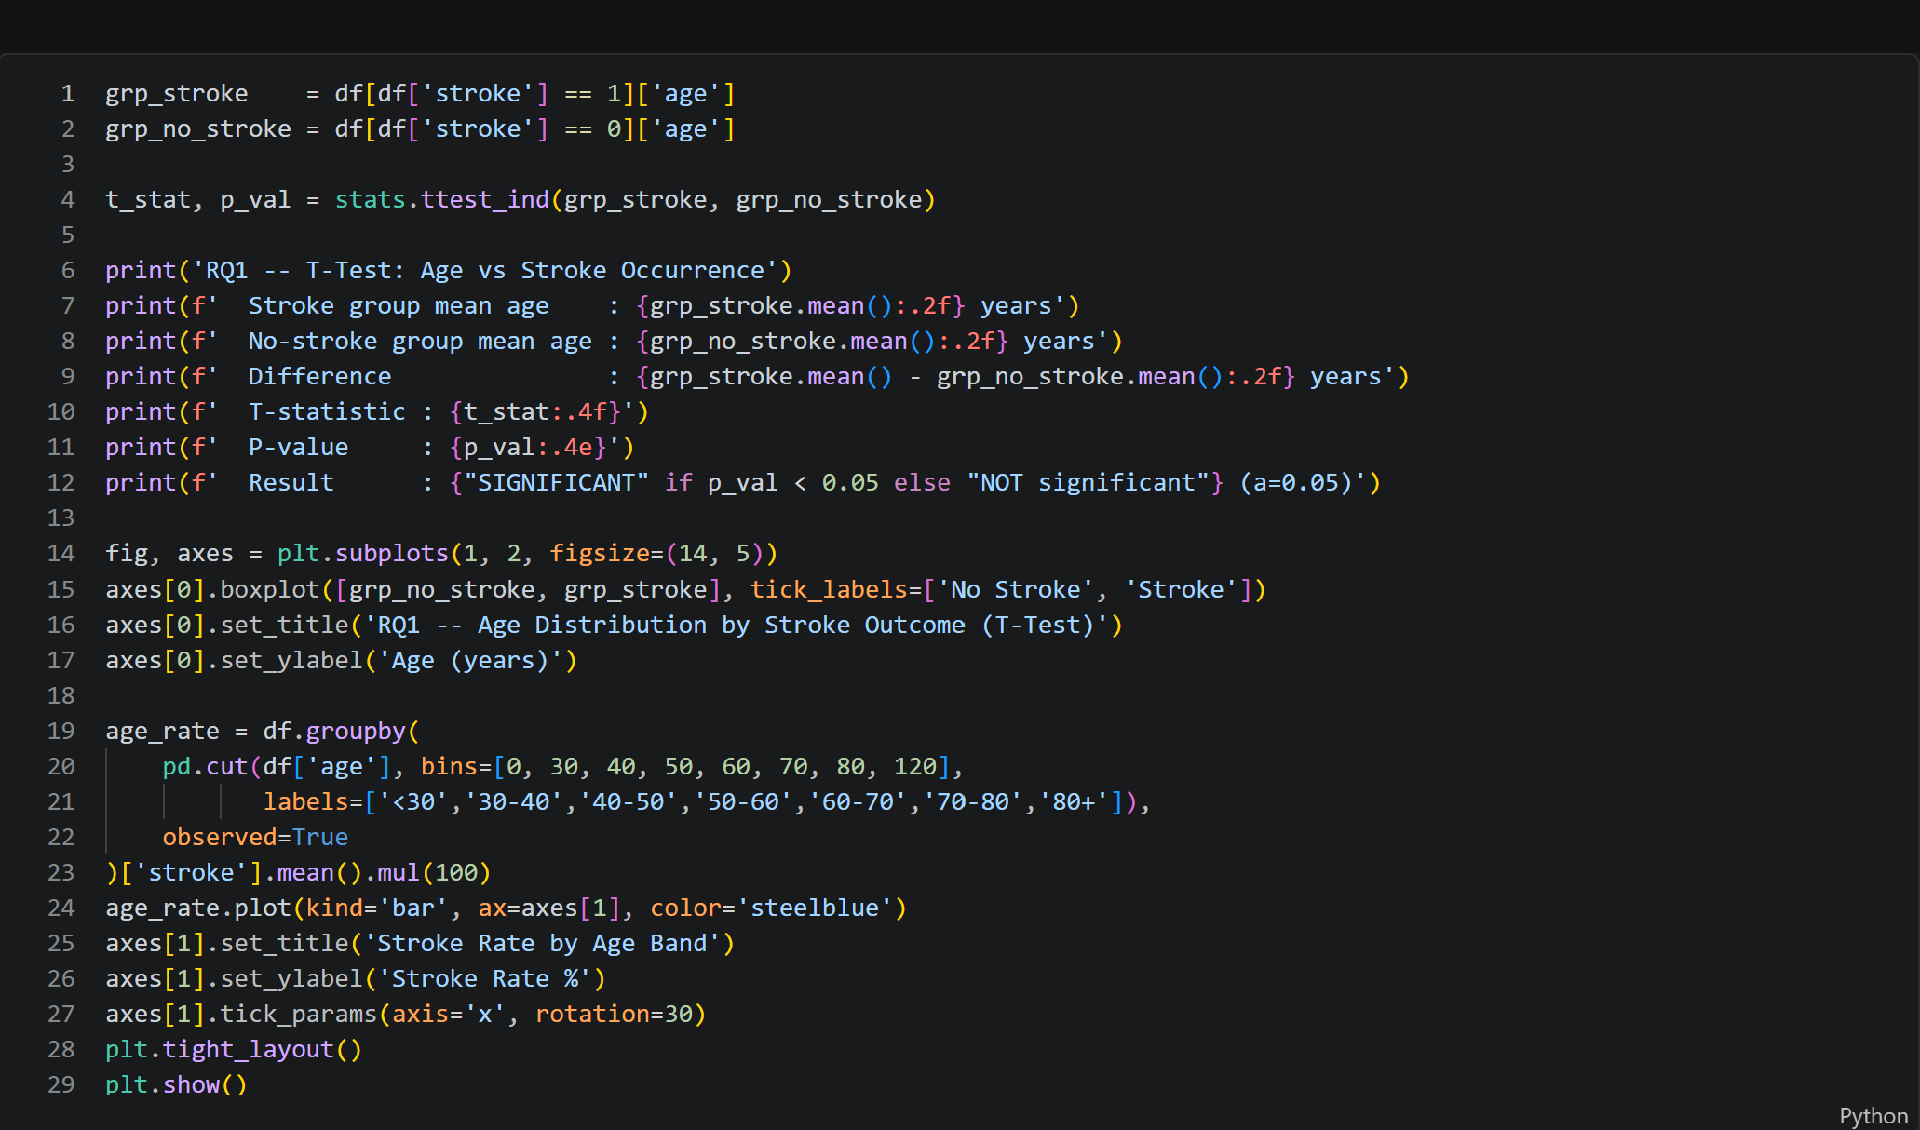
Data Output

